Slide 1
Skynet
Drone Detection System
Prepared by: Abdulaziz Bin Shuhaywin
Faisal al-Meshkhas
Supervised by: Dr.Sghaier Guizani
Dr.Athiq Ahamed
Deep Learning Engnineer: Eng.Afaq Ahmad

Slide 2
Contents
Introduction
Drone security challenges
international and local incidents
SkyNet: The Deep learning Drone hunter
Software
Hardware
DJI MAVIC PRP II
Gathering the Data
Converting videos to Images
Labeling the Images
Training the System
Detection on Images
Detection on Videos
Tracking method
Conclusion
References

Slide 3
Introduction
This project main purpose is to research and explore the possibilities of using Deep learning to counter attack the raising security challenges posed by UAVs and Drones.
As any research and development process we understood that this process is not going to be easy or cheap.
This Project development is still ongoing process and going through a continues improvement.

Slide 4
Drone security challenges
When hobby drones first appeared they were considered nothing more than expansive toys, but with the technology improvements and price drop, drones has become a cheap/disposable easy to use weapons.
The FAA predicts there will be between 1.3 million and 1.7 million hobby drones in the U.S. by 2023.
Commercial Drones also a booming market with companies like Amazon and Domino’s Pizza has been exploring the use of drones in carrying cargo for deliveries which will need a need to be regulated and controlled.

Slide 5
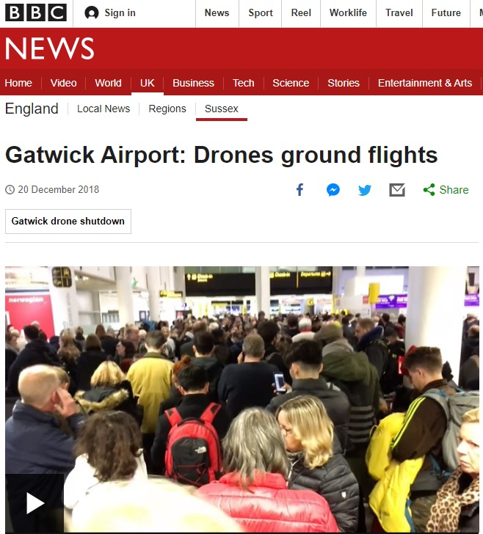
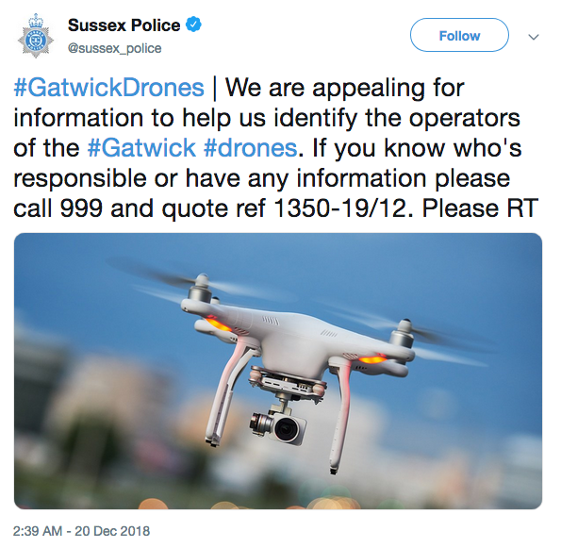
international and local incidents
Gatwick Airport drone incident
Between 19 and 21 December 2018, hundreds of flights were cancelled at Gatwick Airport near London, England, following reports of drone sightings close to the runway. The Drone caused major disruption, affecting approximately 140,000 passengers and 1,000 flights. It was the biggest disruption since ash from an Icelandic volcano shut the airport in 2010. On 21 December.

Slide 6
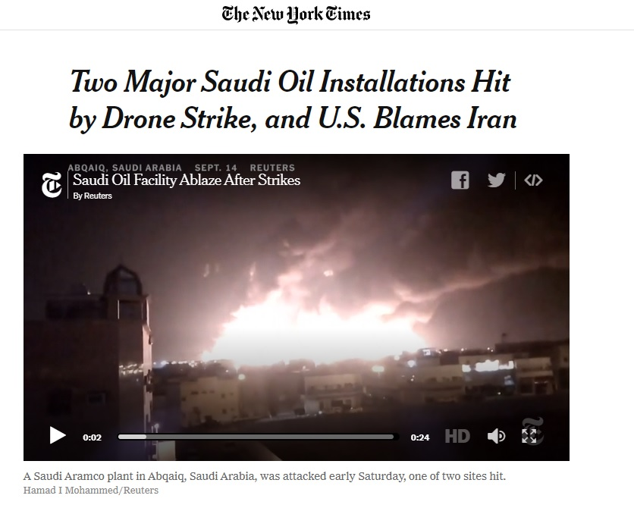
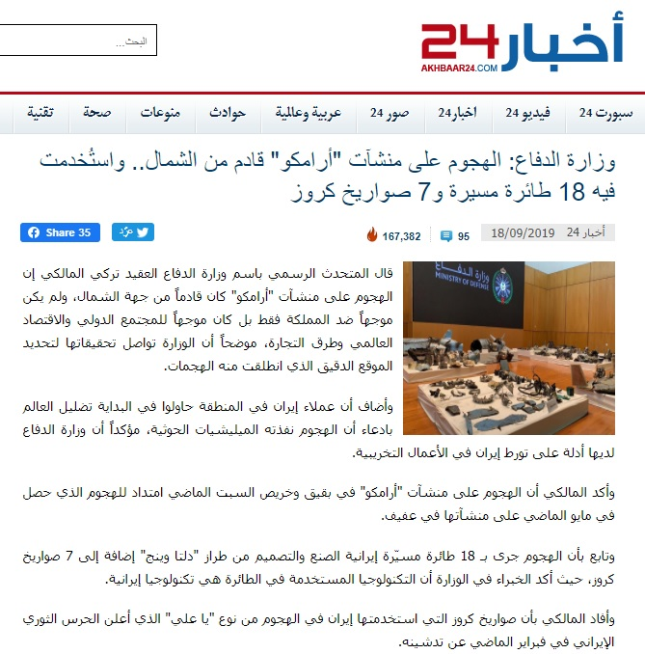
international and local incidents
2019 Abqaiq–Khurais attack
On 14 September 2019, drones were used to attack the Saudi Aramco oil processing facilities at Abqaiq (Biqayq in Arabic) and Khurais in eastern Saudi Arabia.
Government officials said that many more drones and cruise missiles were used for the attack and originated from the north and east, and that they were of Iranian manufacture

Slide 7
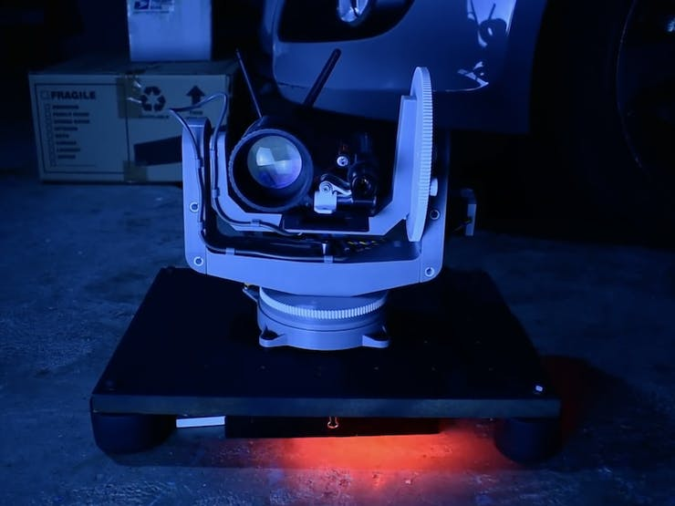
SkyNet: The Deep learning Drone Hunter
SkyNet is a Deep learning Drone detection system
Custom built for speed and agility.
Use Linux for stability, speed and low power consumption.
Based on the Darknet neural network framework.
SkyNet can provide a real-time high accuracy drone detection.

Slide 8

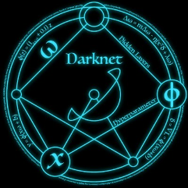


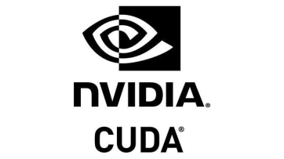

Main Software:
Ubuntu is a free and open-source Linux distribution based on Debian
Darknet is a framework to train neural networks.
YOLOv3 is a popular object detection algorithm YOLO – You Only Look Once.
OpenCV is a library of programming functions mainly aimed at real-time computer vision
CUDA is a parallel computing platform and application programming interface model created by Nvidia.
cuDNN is a GPU-accelerated library of primitives for deep neural networks.

Slide 9
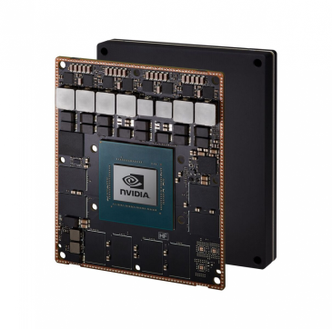
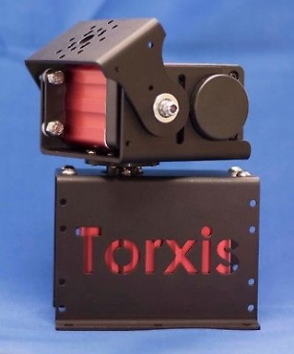
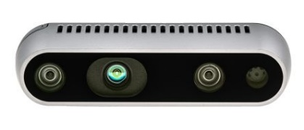
Main Hardware:
NVIDIA Jetson Xavier is an AI computer for autonomous machines, delivering the performance of a GPU workstation.
The Intel® RealSense™ Depth Camera D435 Series uses stereo vision to calculate depth.
Multi-Turn Torxis Servo, Industrial grade Servo with Super High Torque.

Slide 10
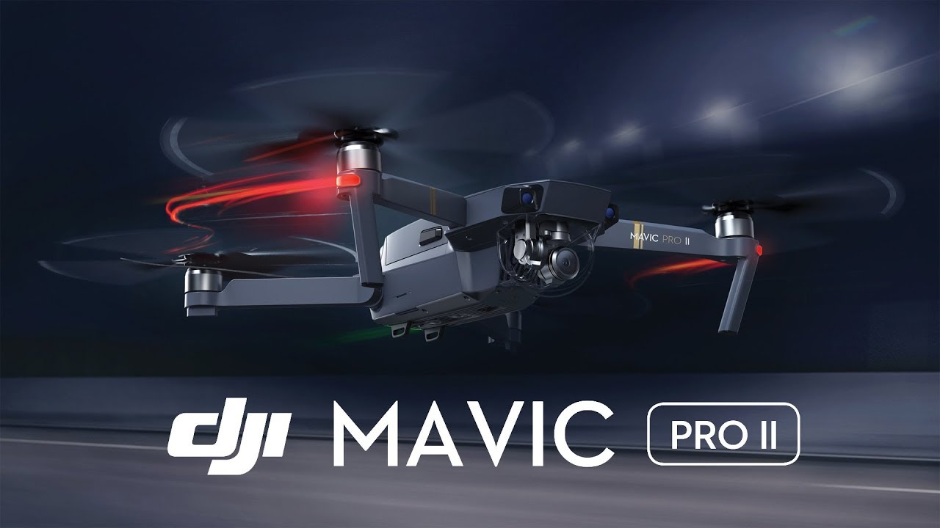
DJI MAVIC PRP II:
Drone Quadcopter UAV with Hasselblad Camera 3-Axis Gimbal HDR 4K Video Adjustable Aperture 20MP 1" CMOS Sensor, up to 48mph

Slide 11
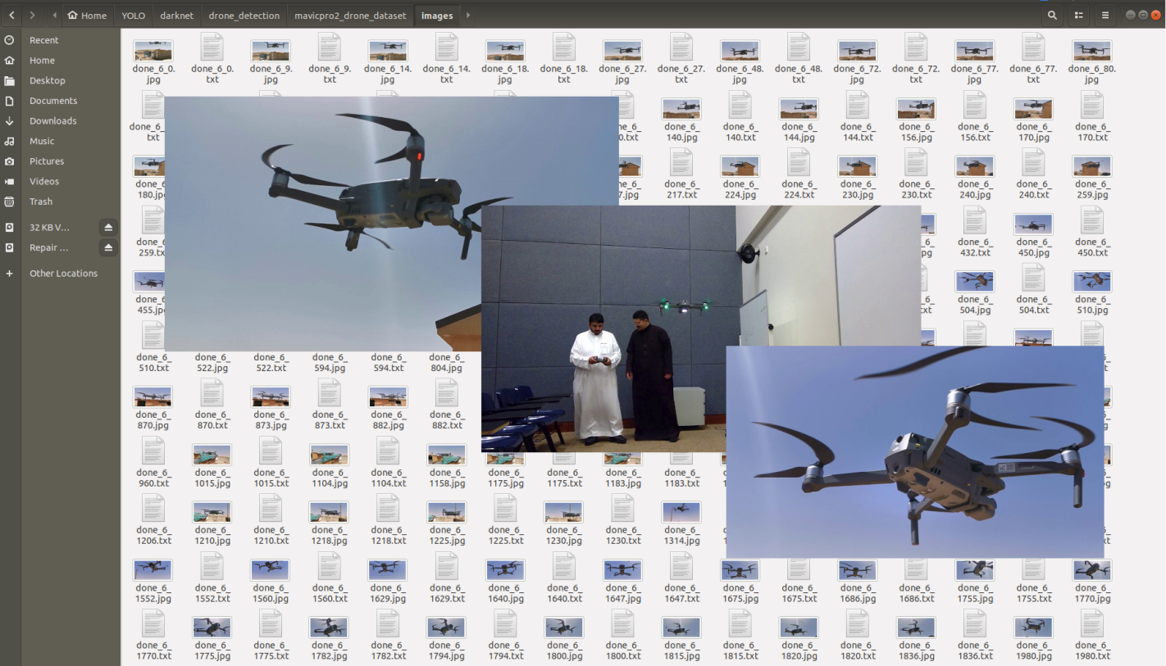
Gathering the Data:
Multiply videos, more than 5 different locations, different light settings

Slide 12
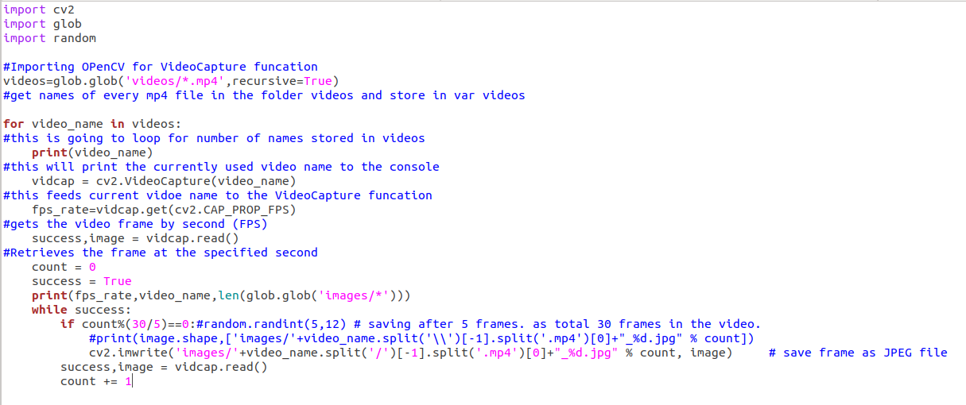

Converting videos to Images:
Using OpenCV to save Video frame as an Image every 5 frames, using the equation $x=\frac{30}{5}$ where x is the saved frame

Slide 13
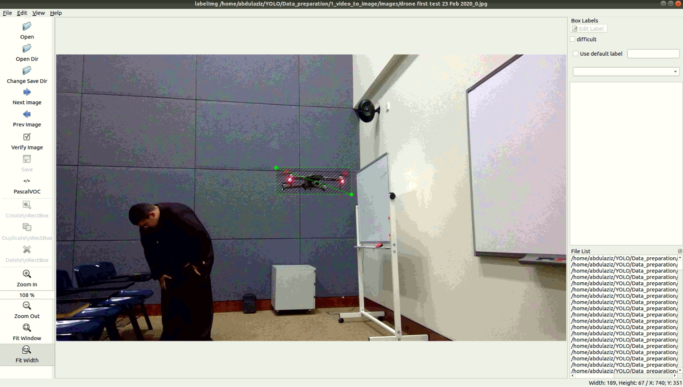
Labeling the Images:
Adding labels to the drone images according to the YOLOv3 format

Slide 14
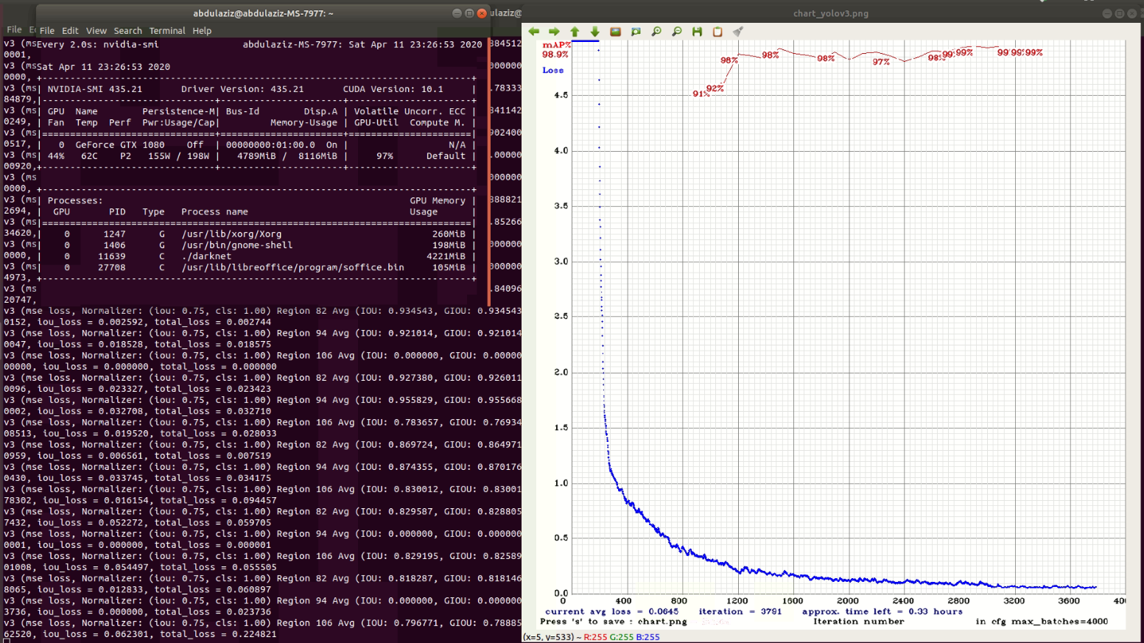
Training the System:

Slide 15
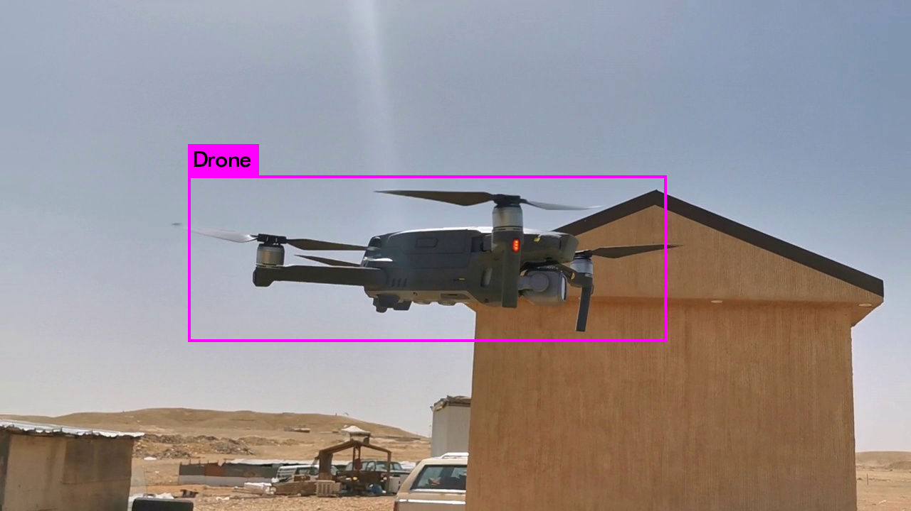
Detection on Images:

Slide 16
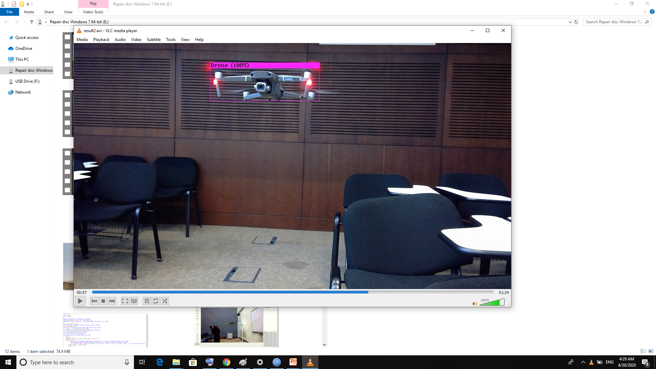
Detection on Video:

Slide 17
Tracking method:
Centroid point
Tilt Movement
pan Movement
Pan Tilt Mechanism using servo motors for tracking drone centroid

Slide 18
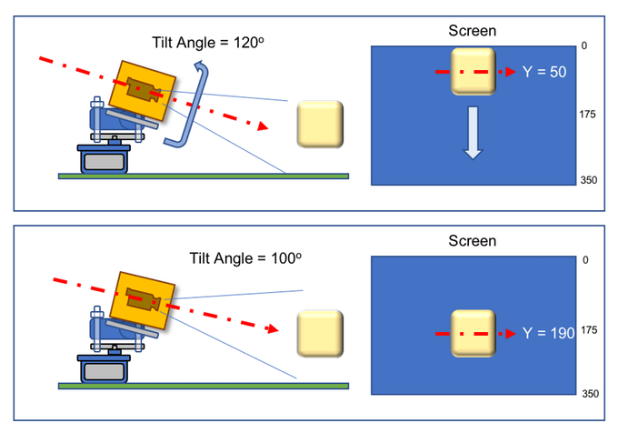
Tracking method:
drone
drone
Servo motors horizontal and vertical movement to move Camera towards drone centroid position.

Slide 19
Conclusion:

Slide 20
References:
LabelImg: https://github.com/tzutalin/labelImg
Yolo: https://github.com/AlexeyAB/darknet
Pan Tilt: https://www.pyimagesearch.com/2019/04/01/pan-tilt-face-tracking-with-a-raspberry-pi-and-opencv/
4. Jetson Xavier:
https://developer.nvidia.com/embedded/jetson-agx-xavier-developer-kit

Slide 21

Thanks

